Slide 1
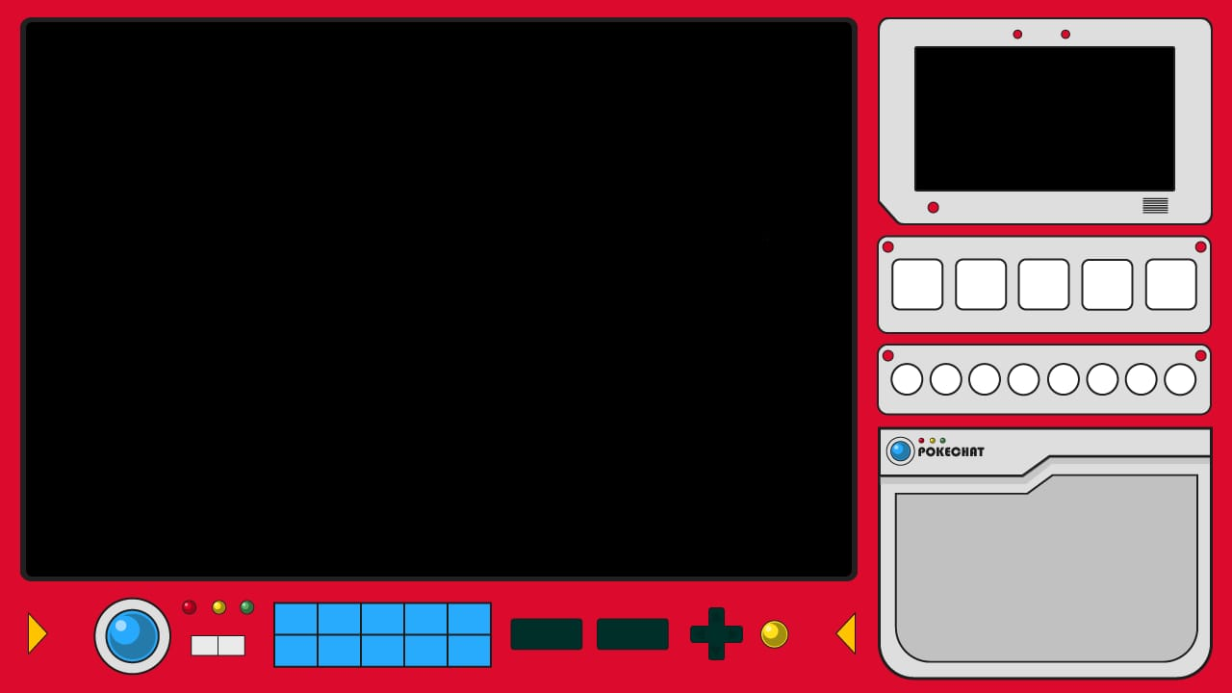

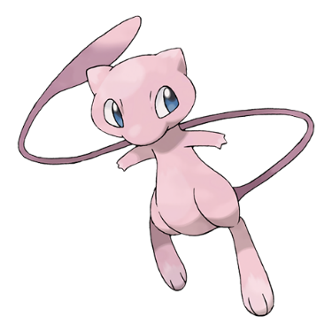


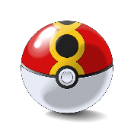





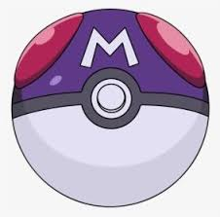





The Pokédex isn’t just a tool—it’s a record of friendship and adventure.
If you believe in your Pokémon, they’ll believe in you too!

